Slide 1
GDC Data Portal
By Yue Shi

Slide 2
Contents
GDC Data Portal
Biomarker files for cancer diagnosis
A working example:
Download a type of biomarker files and the related file&case meta data
Apply sklearn ML library to the data.
Use AWS SageMaker built-in library

Slide 3
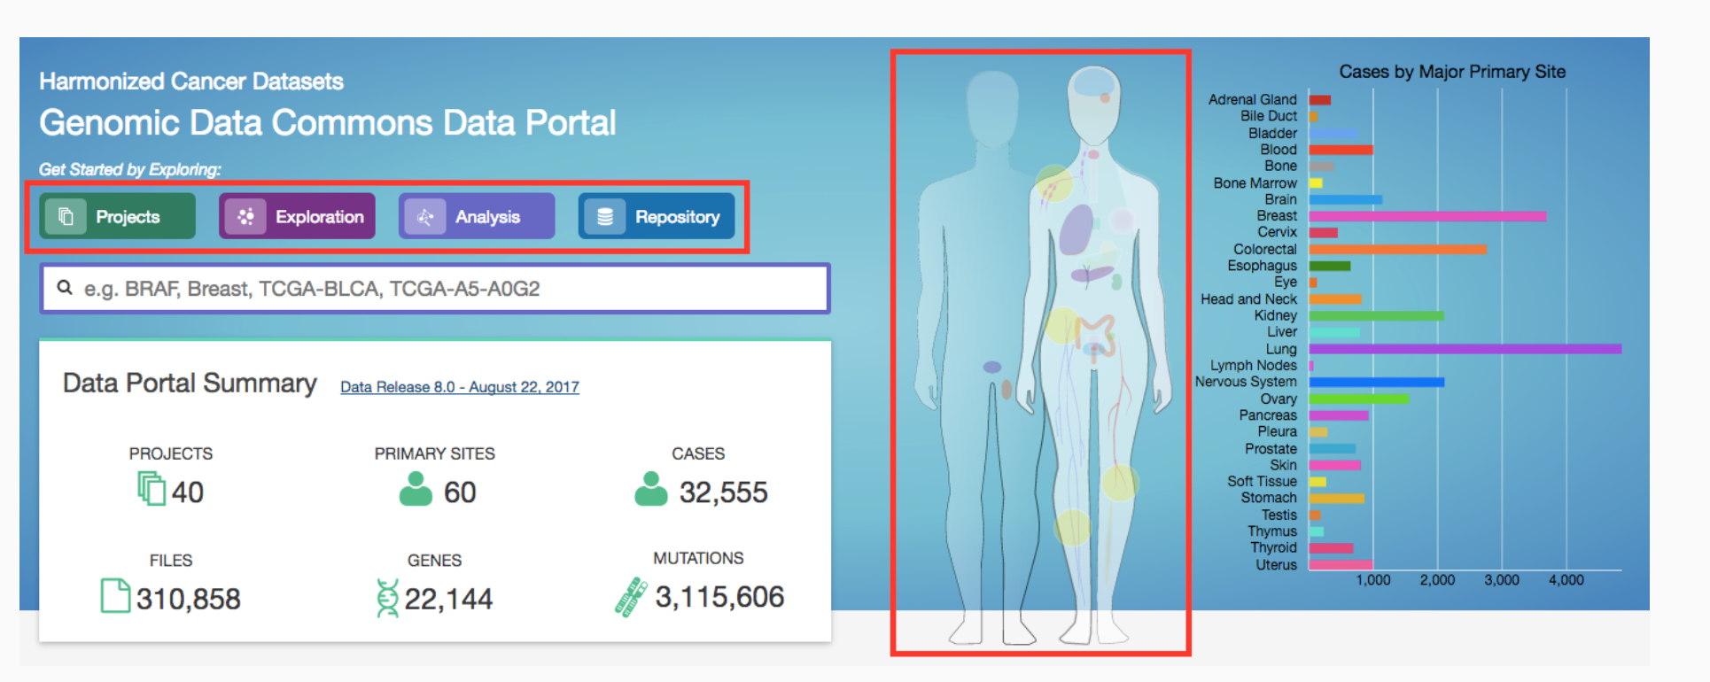
GDC Data Portal

Slide 4
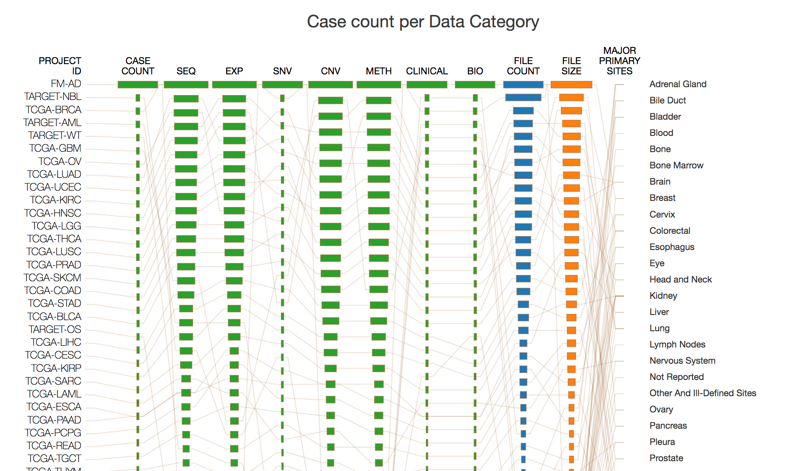
Projects
Raw sequencing data
Transcriptome profiling
Simple Nucleotide Variation
Copy Number Variation
DNA Methylation
Clinical
Biospecimen

Slide 5
Biomarkers
Transcriptome profiling
gene expression quantification
isoform expression quantification
miRNA expression quantification)
Simple Nucleotide Variation
masked somatic mutation
Copy Number Variation
copy number segment
masked copy number segment
DNA Methylation
Methylation beta value

Slide 6
Cancer diagnosis with different biomarkers
Biomarker data | Bioinformatics Pipline | Recent Research
miRNA | https://docs.gdc.cancer.gov/Data/Bioinformatics_Pipelines/miRNA_Pipeline/ | Nikhil Cheerla , and Olivier Gevaert “MicroRNA based Pan-Cancer Diagnosis and Treatment Recommendation.” BMC Bioinformatics, 2017. https://www.ncbi.nlm.nih.gov/pmc/articles/PMC5237282
Somatic mutation data | https://docs.gdc.cancer.gov/Data/Bioinformatics_Pipelines/DNA_Seq_Variant_Calling_Pipeline/ | Marieke Lydia Kuijjer, Joseph Nathaniel ,Paulson, Peter Salzman, Wei Ding & John Quackenbush ”Cancer subtype identification using somatic mutation data”, British Journal of Cancer,volume 118, pages1492–1501 (2018) https://www.nature.com/articles/s41416-018-0109-7
Methylation | https://docs.gdc.cancer.gov/Data/Bioinformatics_Pipelines/Methylation_LO_Pipeline/ | Noushmehr, H. et al. Identification of a CpG island methylator phenotype that defines a distinct subgroup of glioma. Cancer Cell 17, 510–522 (2010).
mRNA | https://docs.gdc.cancer.gov/Data/Bioinformatics_Pipelines/Expression_mRNA_Pipeline/ | Li Y, Kang K, Krahn JM, Croutwater N, Lee K, Umbach DM, Li L. (2017) A comprehensive genomic pan-cancer classification using The Cancer Genome Atlas gene expression data. BMC Genomics 18(1):508. https://bmcgenomics.biomedcentral.com/articles/10.1186/s12864-017-3906-0
Copy number variation analysis | https://docs.gdc.cancer.gov/Data/Bioinformatics_Pipelines/CNV_Pipeline/ | Molparia, Bhuvan, Eshaan Nichani, and Ali Torkamani. “Assessment of circulating copy number variant detection for cancer screening.” PloS one 12.7 (2017): e0180647. https://www.ncbi.nlm.nih.gov/pmc/articles/PMC5501586/

Slide 7
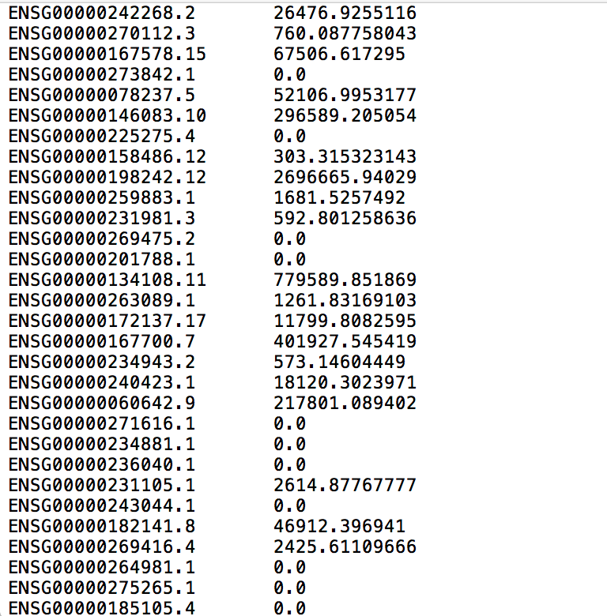
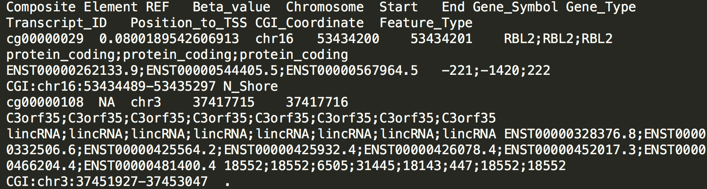
Biomarker file examples
mRNA-seq FPKM file:
DNA methylation:

Slide 8
A working example : miRNA for cancer detection
Github repo:
https://github.com/yuesOctober/GDCproject/tree/yue
Command:
git clone https://github.com/yuesOctober/GDCproject.git

Slide 9
Example: Download miRNA files
Data transfer tool
miRNA manifest file Download
miRNA File Download
File Meta Data Download
Case Meta Data Download

Slide 10
Data Transfer Tool
https://gdc.cancer.gov/access-data/gdc-data-transfer-tool
System requirement
Use t2.large AWS instance
Command line to download:
wget -c -t 0 https://gdc.cancer.gov/files/public/file/gdc-client_v1.3.0_OSX_x64.zip

Slide 11
Download File Manifest
For Large volume data
Methods:
From the data portal
Use the API

Slide 12
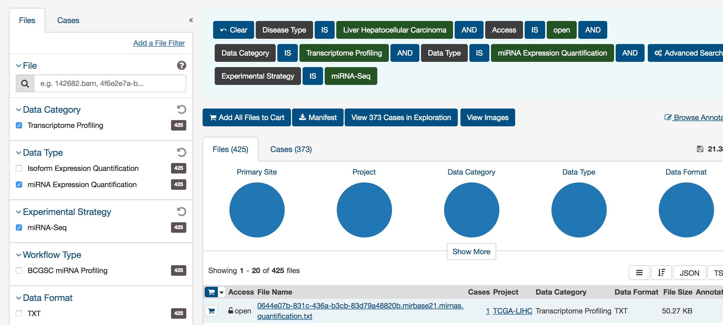
Download File Manifest-- From Data Portal
Download the manifest file locally.
Transfer the file to your aws instance

Slide 13
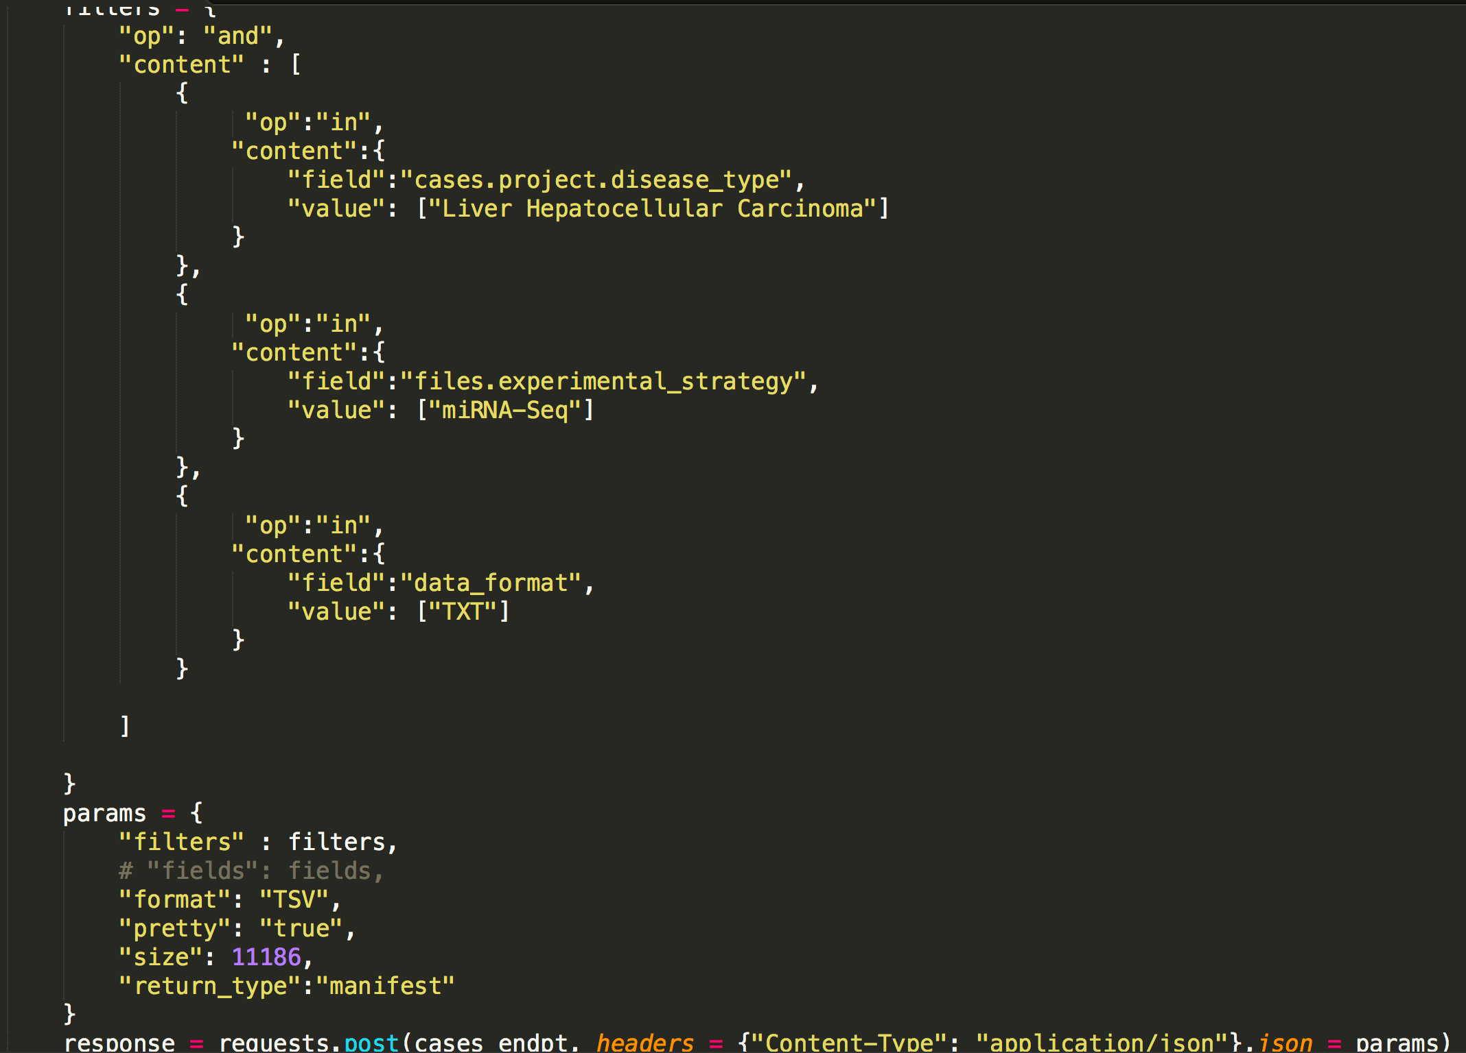
Download file manifest-- From the API

Slide 14
Download Files with GDC Tool
Command:
./<path-to-gdc-client>/gdc-client download –m <path-to-manifest-file>

Slide 15
Get File/Case Meta Data
1. Get the case ID for the file ID.
2. Get the File Meta data for the files through file API
3. Get the Case Meta data for the corresponding cases through case API

Slide 16
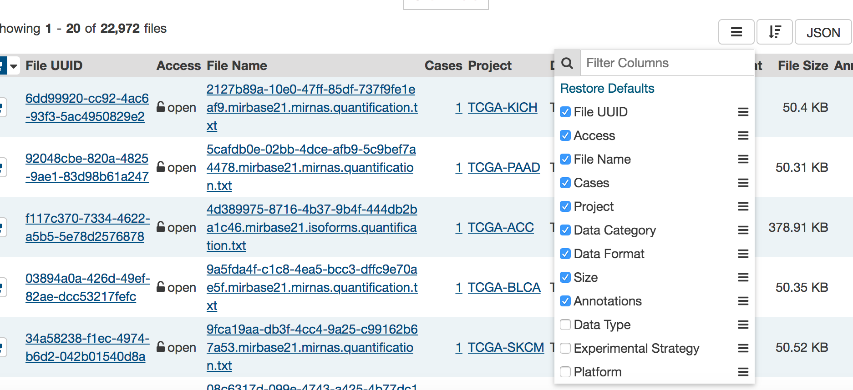
Get File/Case ID

Slide 17
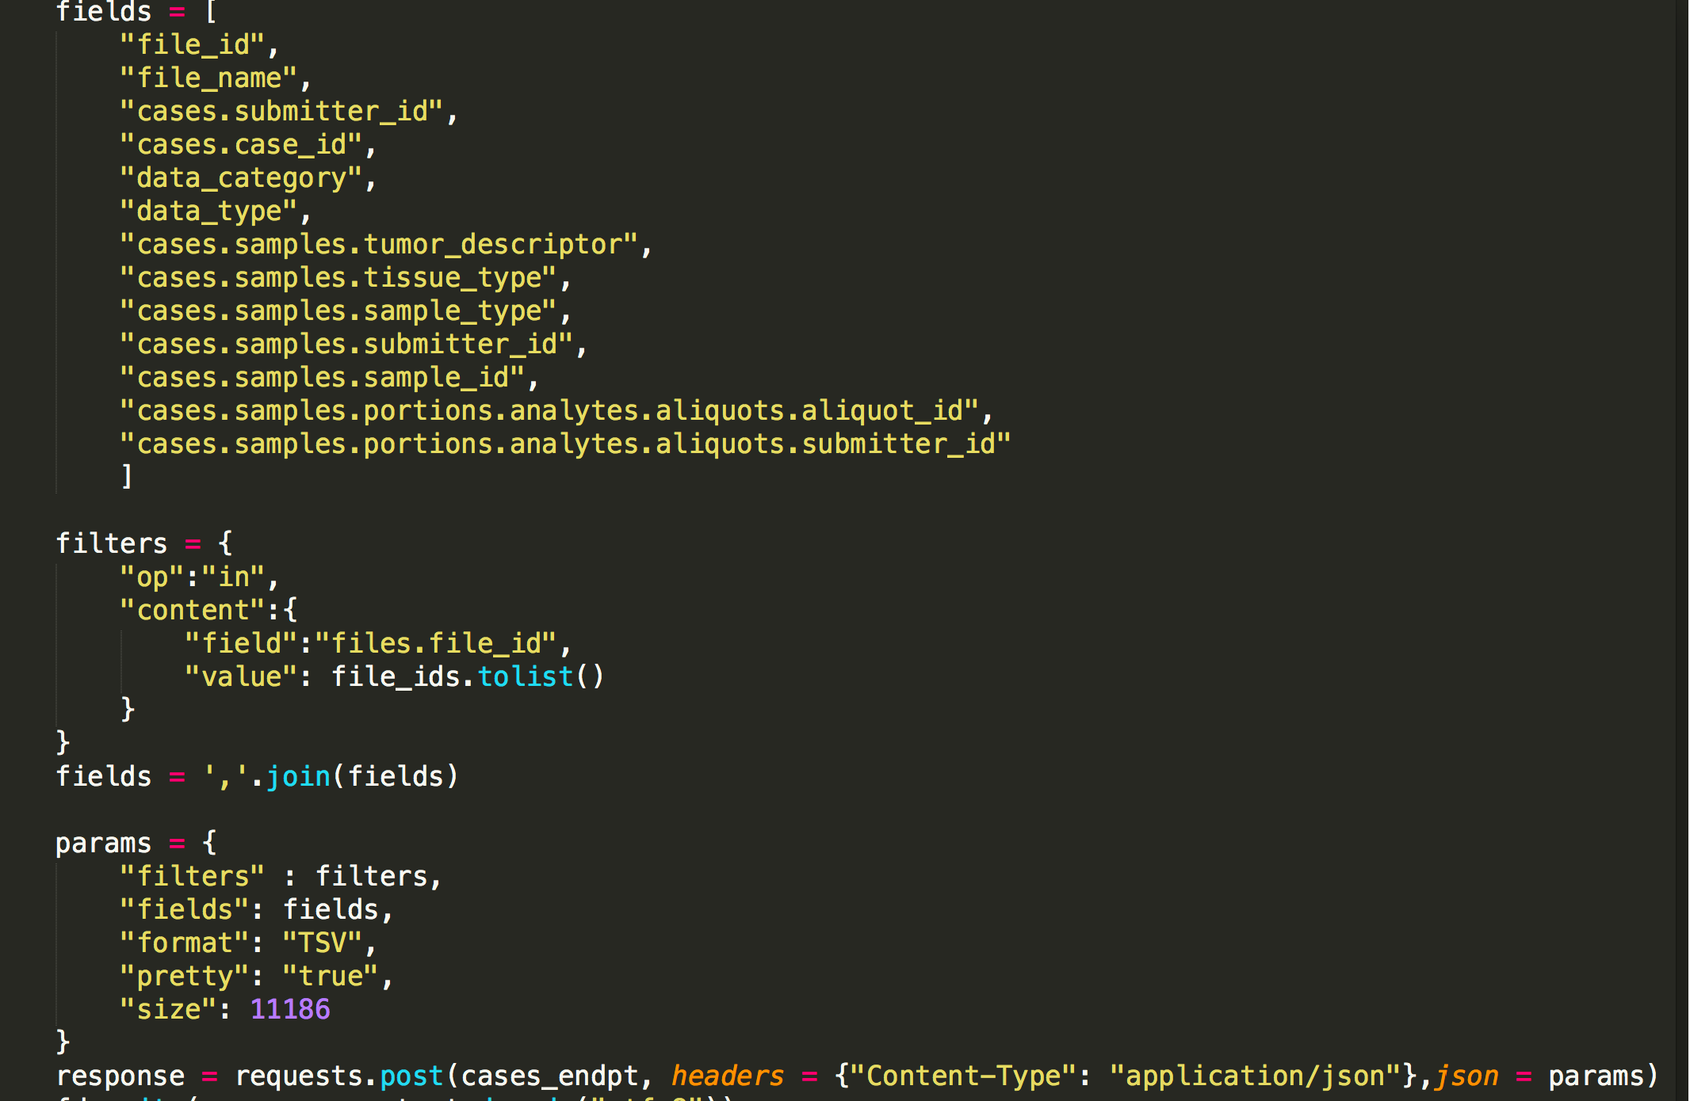
File Meta Data Retrieve API
Case fields:
https://docs.gdc.cancer.gov/API/Users_Guide/Appendix_A_Available_Fields/#file-fields

Slide 18
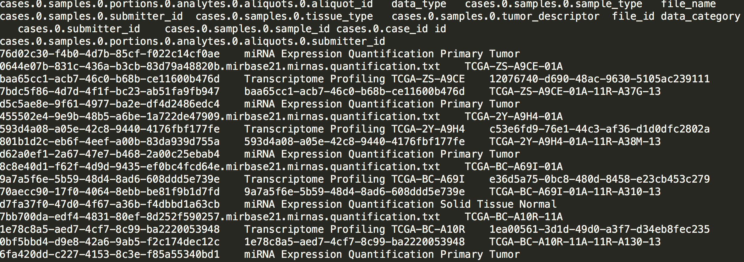
An example of File Meta Data

Slide 19
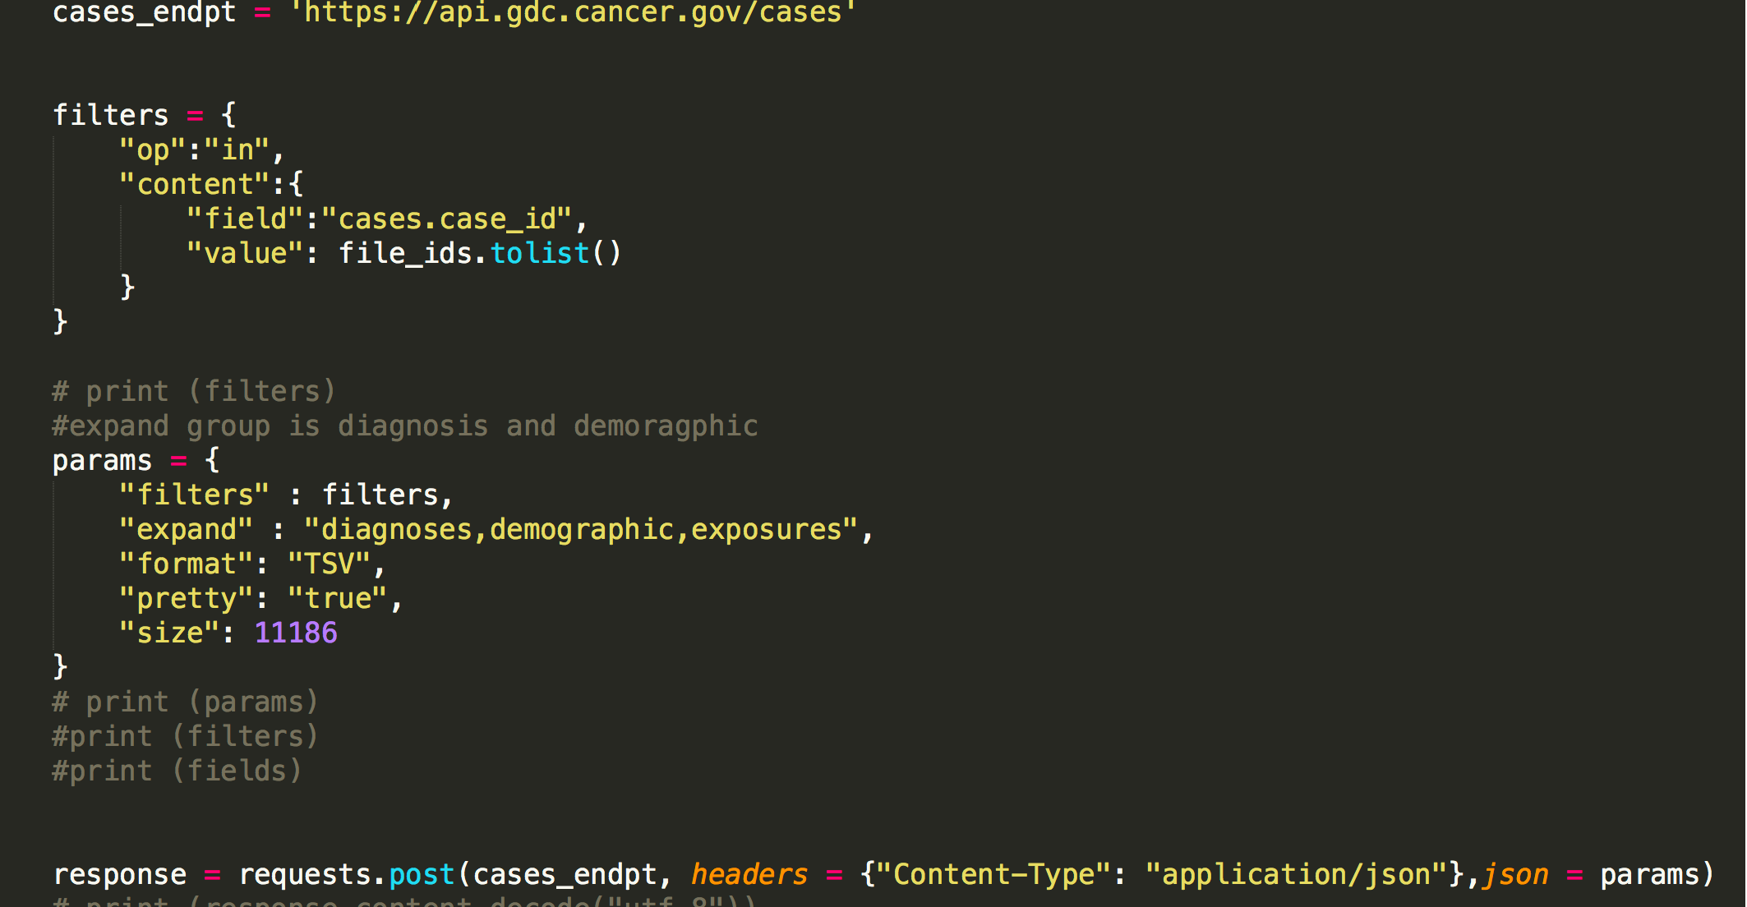
Case Meta Data Retrieve API
Case fields:
https://docs.gdc.cancer.gov/API/Users_Guide/Appendix_A_Available_Fields/#case-fields

Slide 20
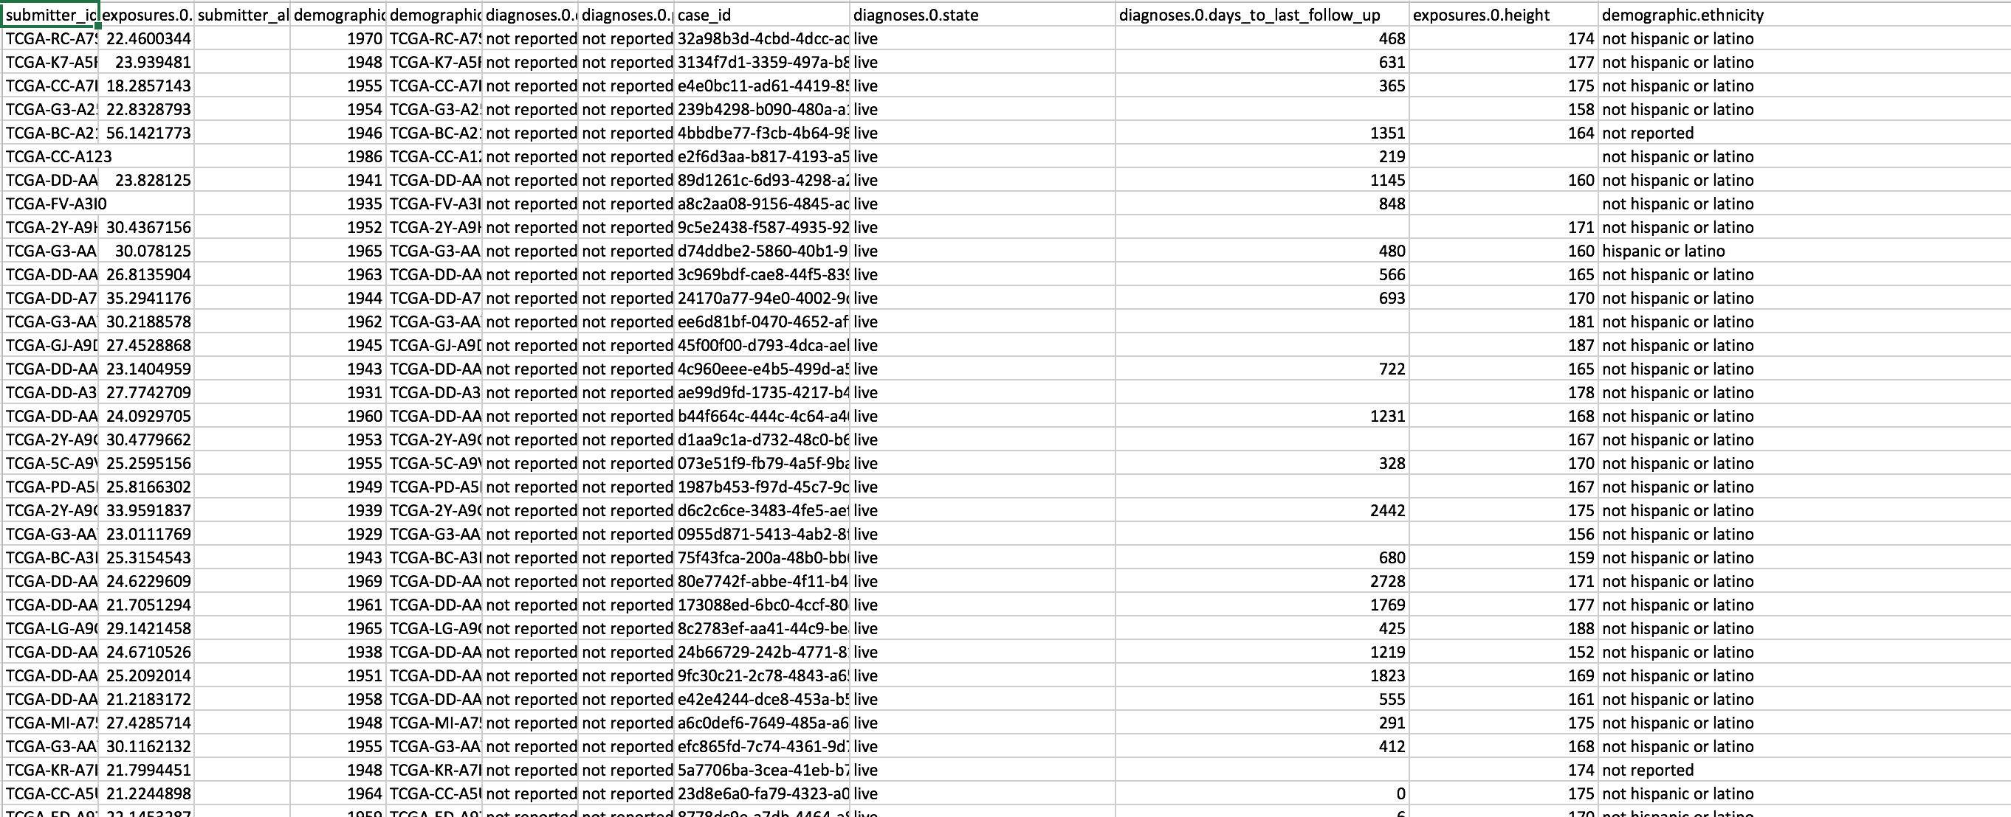
An example of Case Meta Data

Slide 21
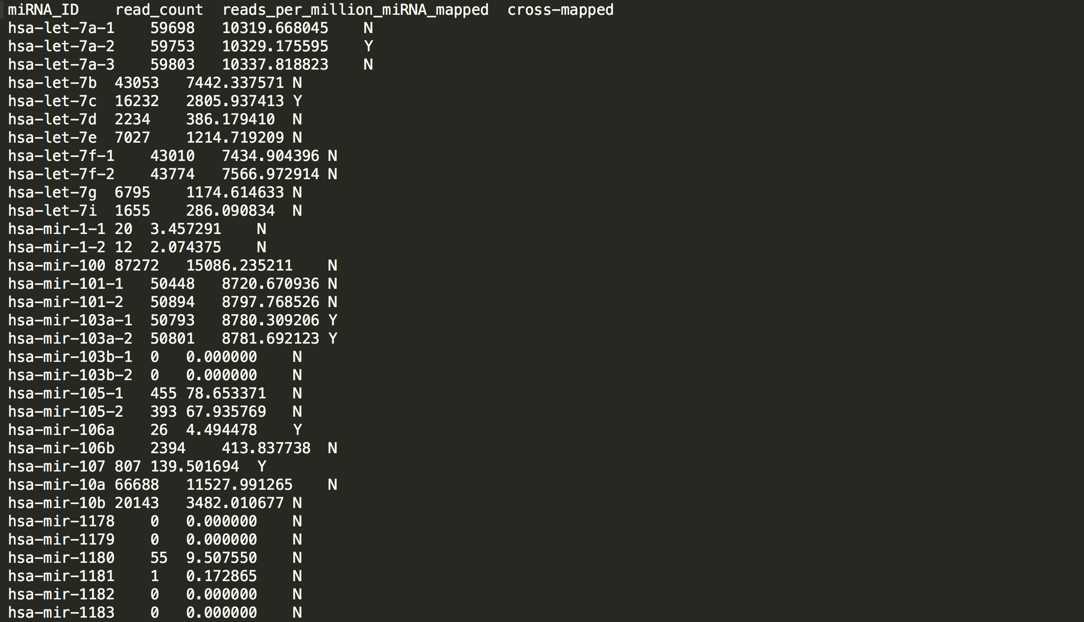
miRNA sequence data for one sample

Slide 22
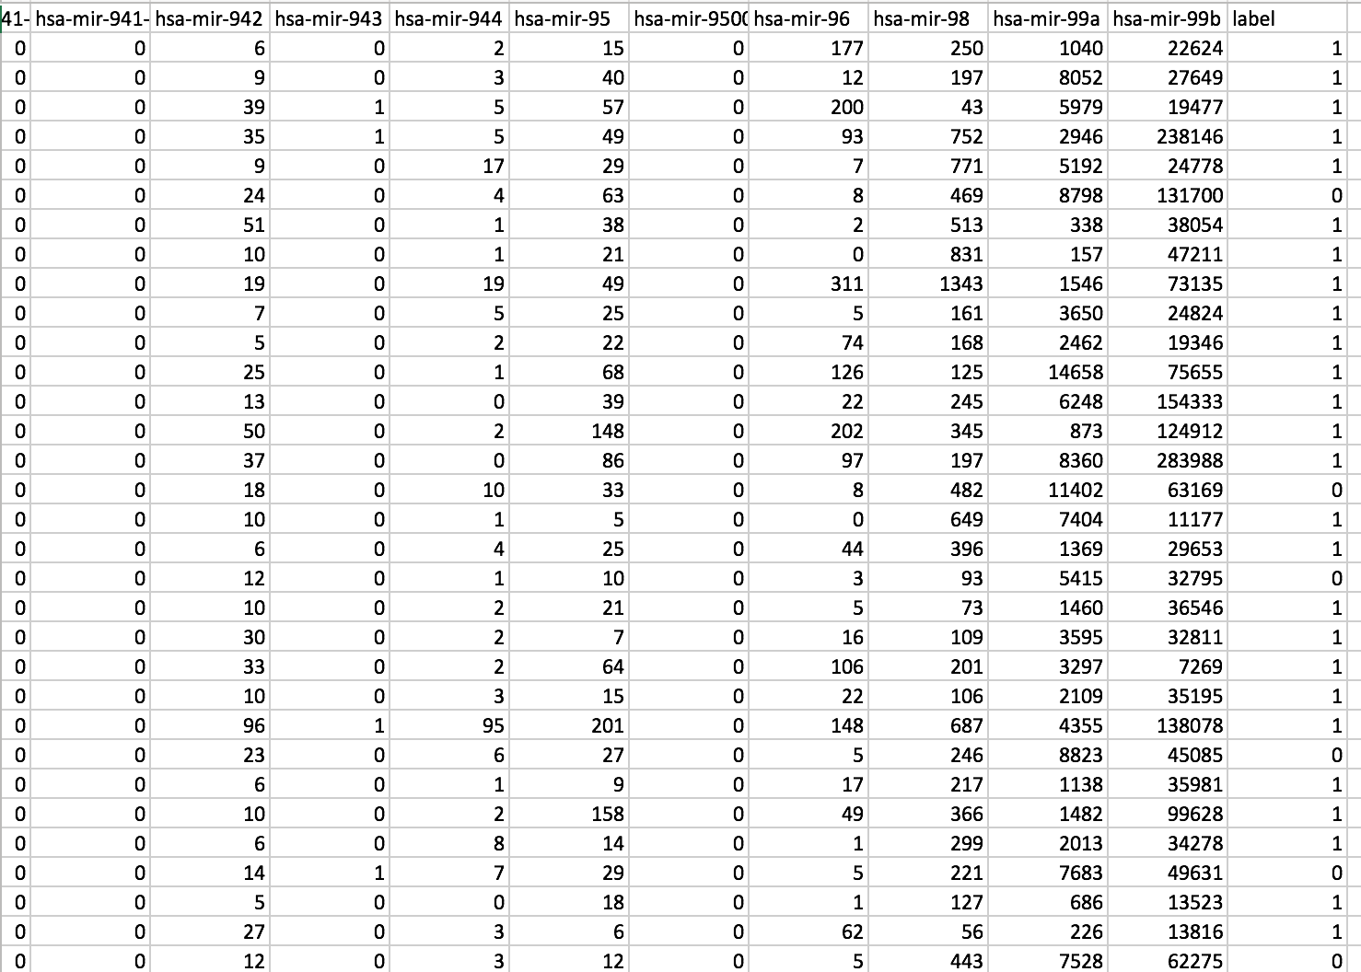
Generate the miRNA read_count matrix for all samples
Label 1: Tumor
Label 0: Normal

Slide 23
Machine Learning Steps:
1. Data standardization.
2. Split training and test data.
3. Feature selection.
Lasso feature selection
Remove features with low variance.
Tree based feature selection
4. Model hyper-parameters tuning with cross validation
5. Prediction with the best hyper-parameters
6. Evaluation: Precision, Sensitivity, Accuracy, F1-score, Specificity

Slide 24
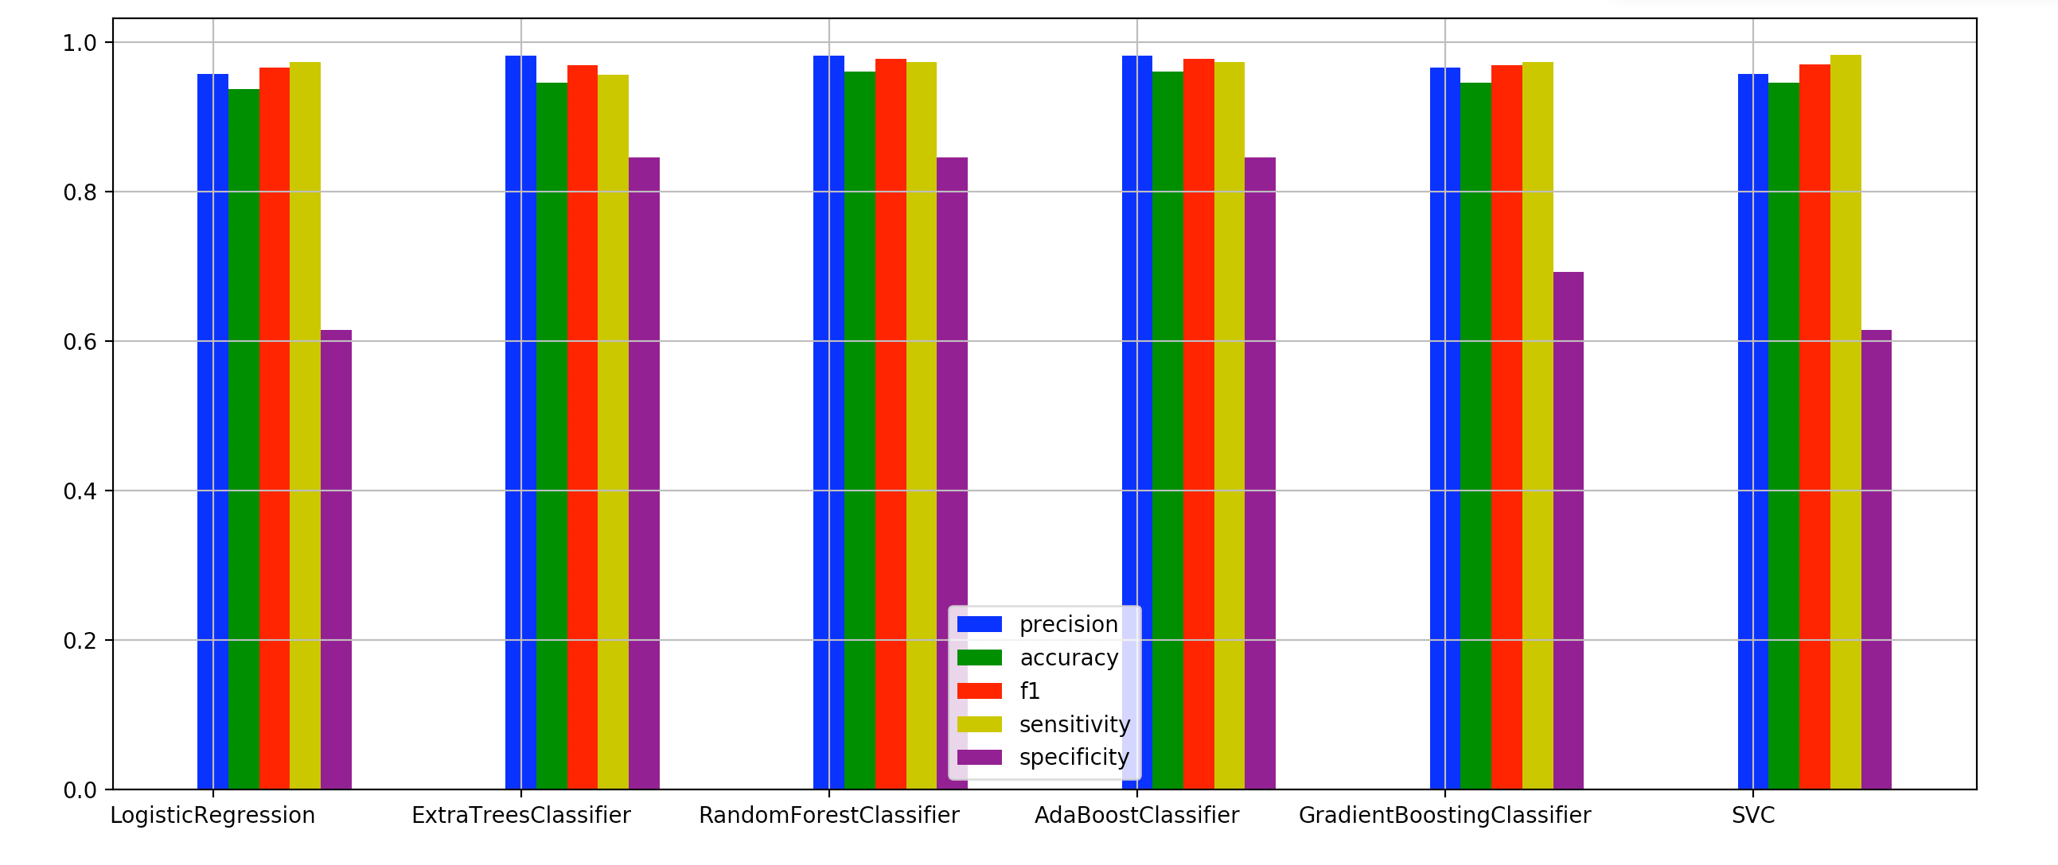
Result from sklearn package

Slide 25
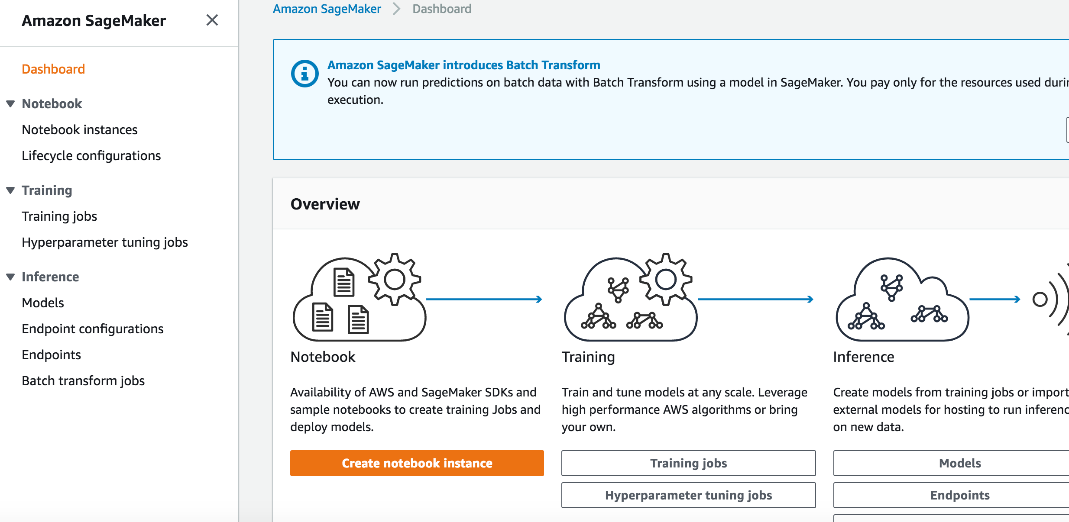
AWS SageMaker
A fully-managed platform that enables developers and data scientists to quickly and easily build, train, and deploy machine learning models at any scale.

Slide 26
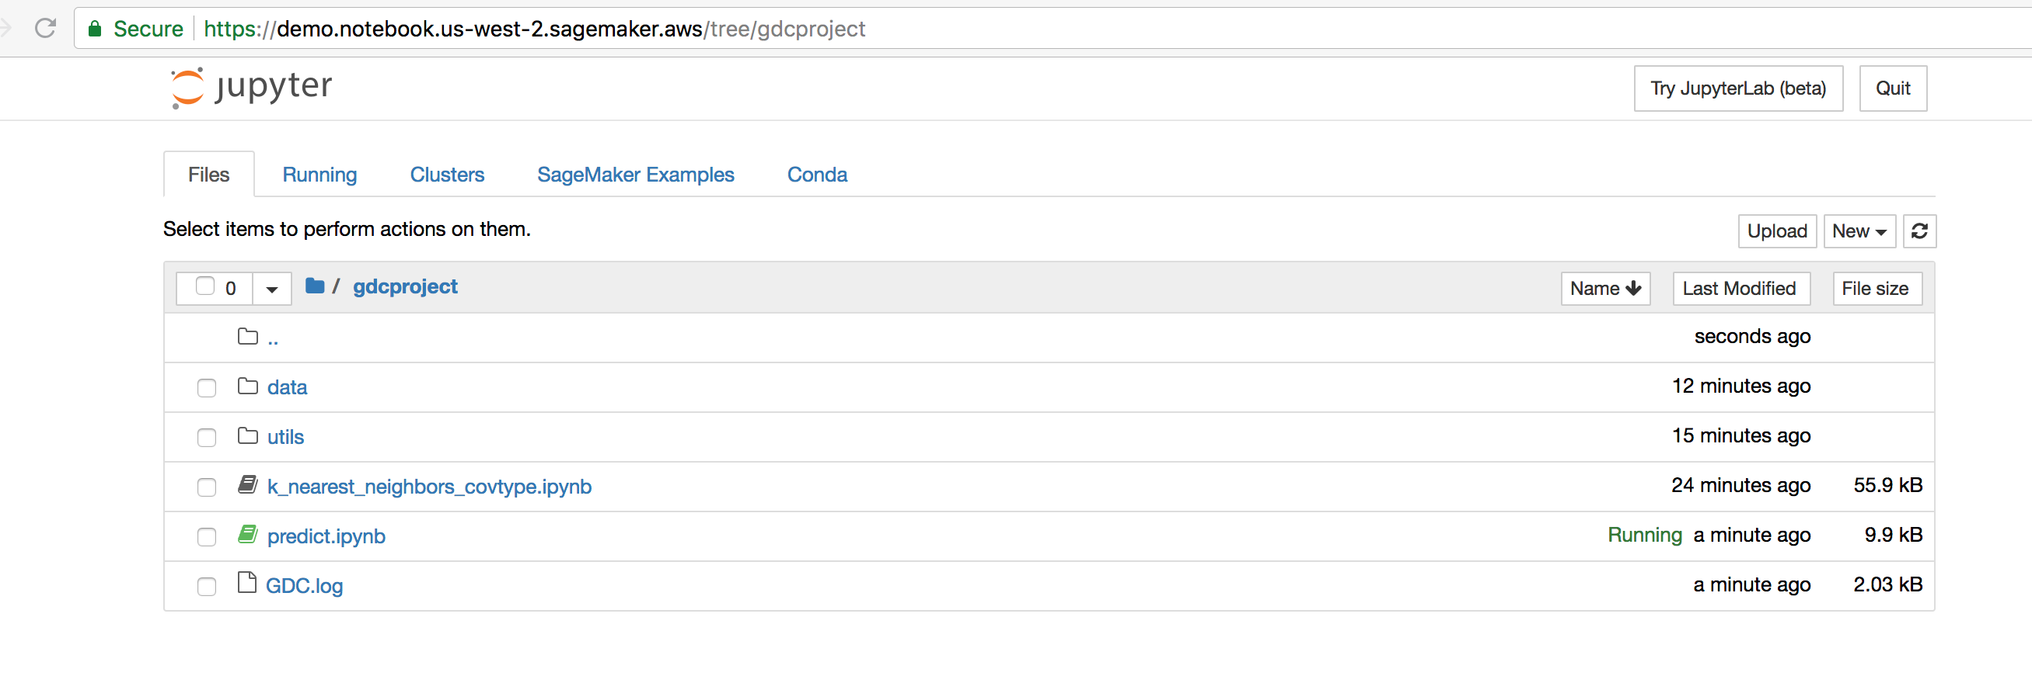
Run the provided code in AWS SageMaker

Slide 27
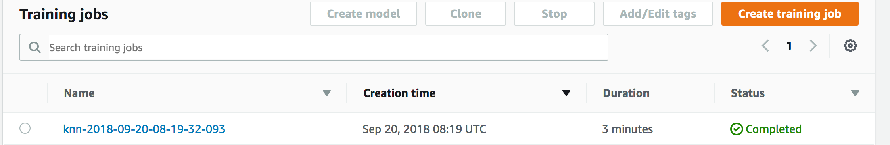
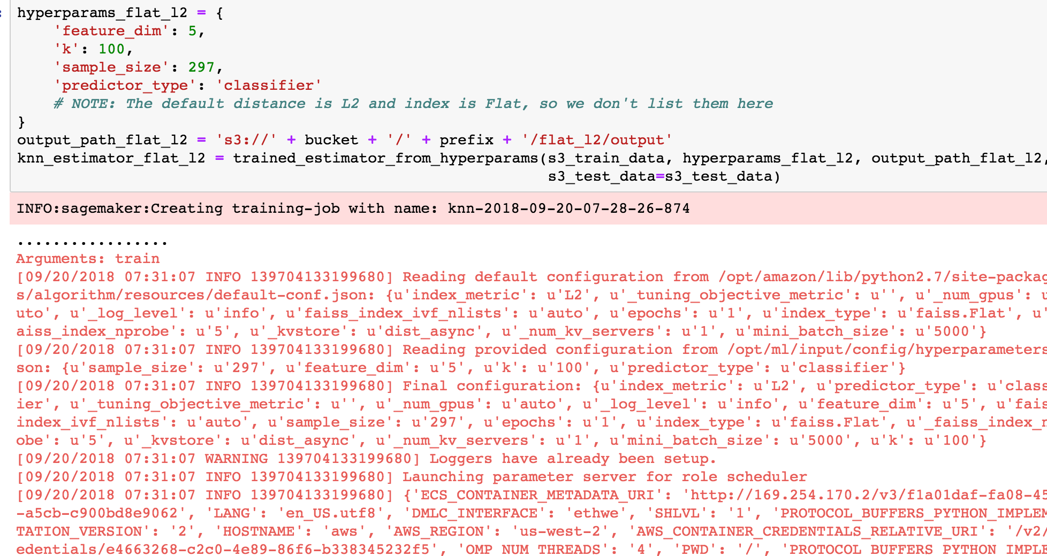
Training jobs

Slide 28
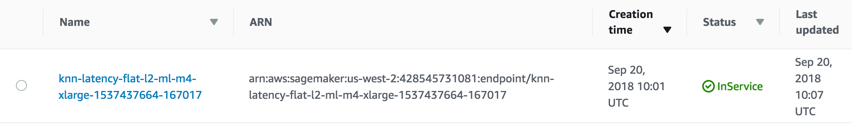
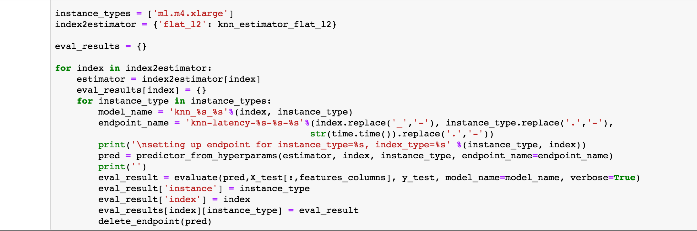
Prediction with endpoints

Slide 29
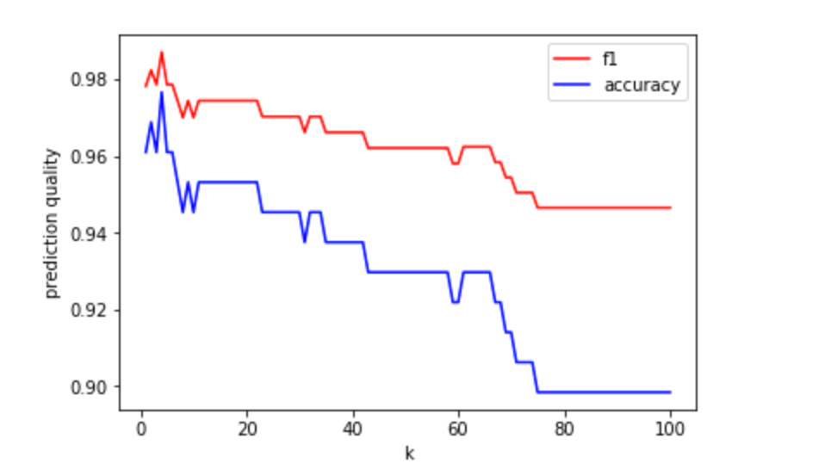
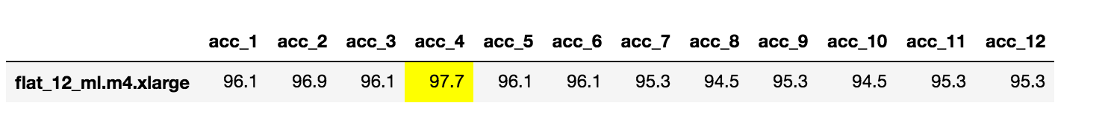
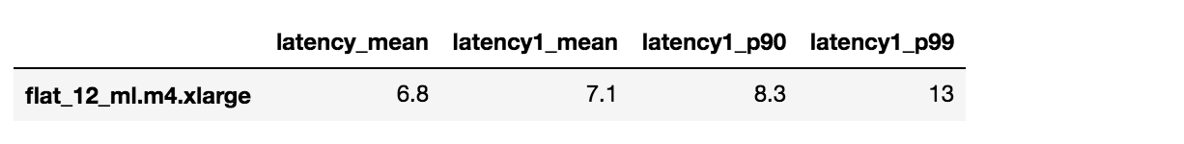
Apply the built-in KNN algorithm for the Data
Accuracy vs k
Latency

